Slide 1


Relevant Posts,
Happy Users
A presentation to Reddit APAC Senior Management
Leveraging machine learning techniques to improve content moderation and grow user base
By: Team DSI-23 - Kimberley Chen, Andrew Chia, Timothy Chan, Lee Shi Min

Slide 2
Agenda
01
02
03
04
Introduction
and Problem Statement
Exploratory Data
Analysis
Modelling
and Evaluation
Conclusions and Recommendation

Slide 3
52 MILLION
303.4 MILLION
49.2 BILLION
52 Million Daily Users on Reddit in 2020
303.4 Million posts on Reddit in 2020
49.2 Billion Upvotes on Reddit in 2020

Slide 4
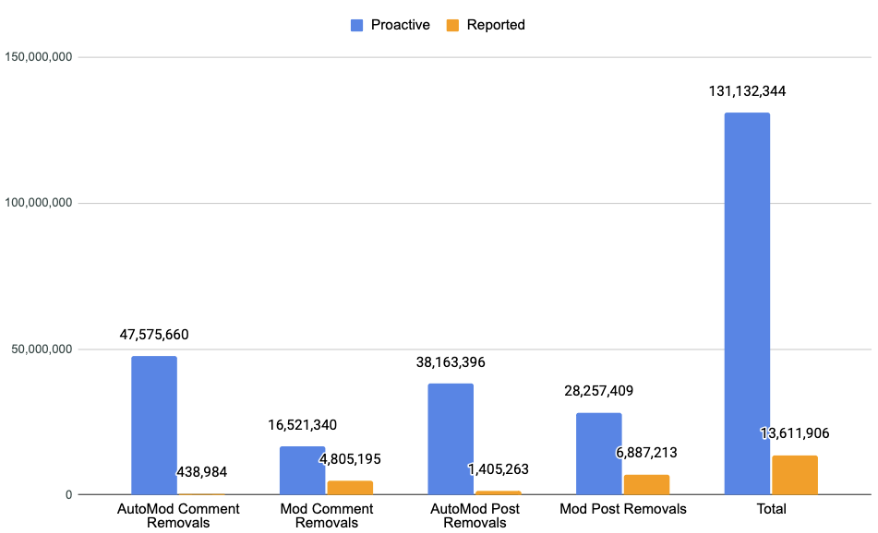
Content optimisation is a cornerstone...
… backed by extensive moderation efforts
High impact on user retention, engagement and growth
> 70,000 volunteer moderators are critical partners to ensure posts are safe, original, authentic
AutoModerator tool introduced in 2019
More than 100 million posts removed in 2020!

Slide 5
2 types of moderators:
Auto Moderator
Human Moderator
AutoModerator is a system built into reddit that allows moderators to define "rules" to be automatically applied to posts in their subreddit.
Redditors who volunteer their time to help guide and create Reddit's many communities.
Able to report or remove comments or submissions containing certain words or phrases
Able to report or remove comments or submissions containing certain words or phrases
Ban spammers or other redditors who may be breaking community rules from posting or commenting in their community.

Slide 6

Improving moderation efforts and content optimisation
Scope to further curate posts for relevance
Easing moderation work
Leverage machine learning tools to help moderators complete key tasks with less time
More moderators stepping up to support communities
Relevant posts keep users reading and engaged
A more vibrant reddit community

Slide 7
This project aims to apply machine learning techniques to curate and flag irrelevant content posts within each subreddit so as to improve the quality of users’ experience and grow the active user base for better advertising revenue potential.
In classifying the posts, we also want to mitigate the risk of losing users to inappropriate removal of posts when they are actually relevant to the thread.

Slide 8
2 Datasets that were used:
Stocks
CryptoCurrency
2.9 million community members
Created on 27 June 2008
3.3 million community members
Created on March 11 2013
Data Size:
1,700
Time Range:
July 21, Wednesday 2021 (GMT)
July 22, Thursday 2021 (GMT)
Data Size:
1,700
Time Range:
July 21, Wednesday 2021 (GMT)
July 17, Saturday 2021 (GMT)

Slide 9
Outline of our Workflow
Insights and
Recommendations
Web Scraping
EDA
Step 1
Step 2
Step3
Step 4
Step 5
Cleaning of the Data
Modelling

Slide 10



Data Cleaning / Data Processing
Data Cleaning
Natural Language Processing Techniques
Vectorization
Filtering null values and [removed]
Remove duplicate entries
Removing punctuations
Tokenizing
Remove stopwords
Done lemmatization (more accurate compared to stemming)
Count Vectorization
N-Gram Vectorization
TF-IDF Vectorization

Slide 11
Exploratory
Data Analysis
To understand more about 2 datasets from r/stocks and r/CryptoCurrency

Slide 12
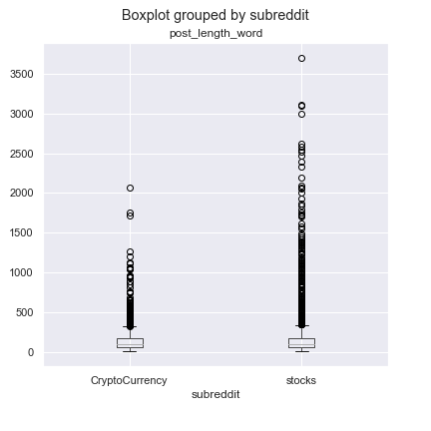
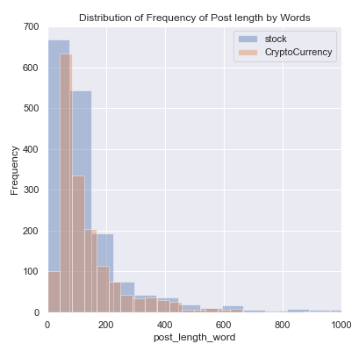
Length of subreddit posts by Word Count
Stocks subreddit have higher mean due to presence of more post >2000 words.
Based on distribution, most post from both subreddits have < 400 words.
1
2
1
2

Slide 13
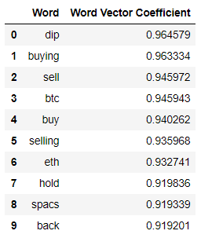
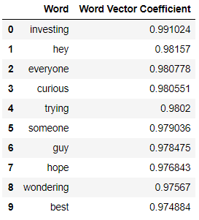
Most related words to “stocks” & “Crypto”
By using Word Vectorization, following words are top 10 related words with ‘stocks’ and ‘crypto’
However, words belonging to Cryptocurrency category appears in words related to stocks.
Therefore, this highlights the potential challenge we will faced in classification modelling later.
Stocks
Crypto
1
1

Slide 14
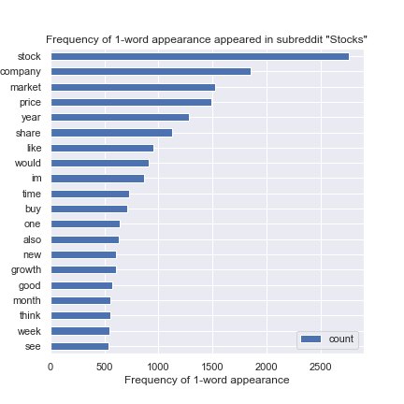
1-word appear frequently in ‘Stocks’
Most words are not a surprise:
‘company’: Stocks is a company’s equity.
‘market’: Place that we buy/sell stocks.
‘price’: Indicator on how a stock performs.
‘share’: Synonym to stock.
Some Insights
There are some words that shows optimism towards the stock market
Words: ‘buy’, ‘growth’,’good’

Slide 15
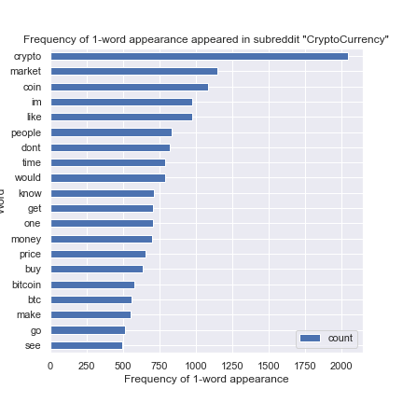
1-word appear frequently in ‘CryptoCurrency’
Most words are not a surprise:
‘market’: Place that we buy/sell crypto.
‘coin’: Synonym to cryptocurrency.
‘price’: Indicator on how a cryptocurrency performs.
Some Insights
The most discussed cryptocurrency is Bitcoin
Words: ‘bitcoin’, ’btc’

Slide 16
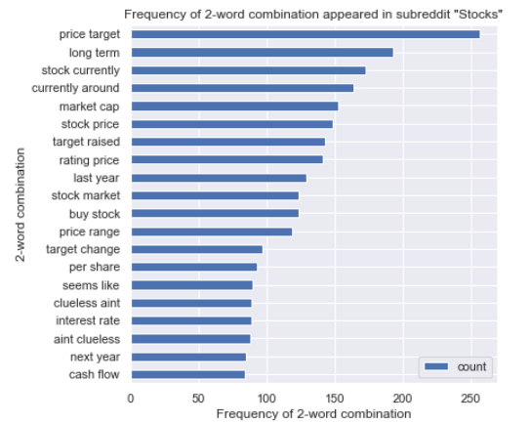
2-words appear frequently in ‘Stocks’
Most words are not surprise:
‘price target’: while buying/selling stocks, people set a price target to rip the gain or to stop loss.
‘market cap’: total dollar market value of a company’s outstanding shares of stock.

Slide 17
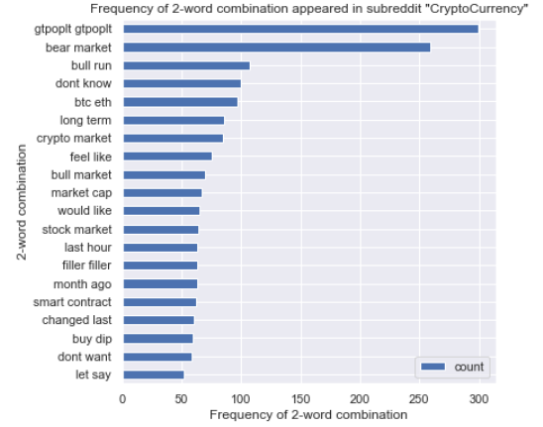
2-words appear frequently in ‘CryptoCurrency’
Some Insights
Some words indicating the more discussed cryptocurrency
“gtpoplt gtpoplt” - Gifto, PlanetPay
“btc eth” - Bitcoin, Ethereum
Mixed sentiments in crypto market due to high volatility
“bull run” + “bull market”
v.s.
“bear market” + “buy dip”
1
1
2
2

Slide 18
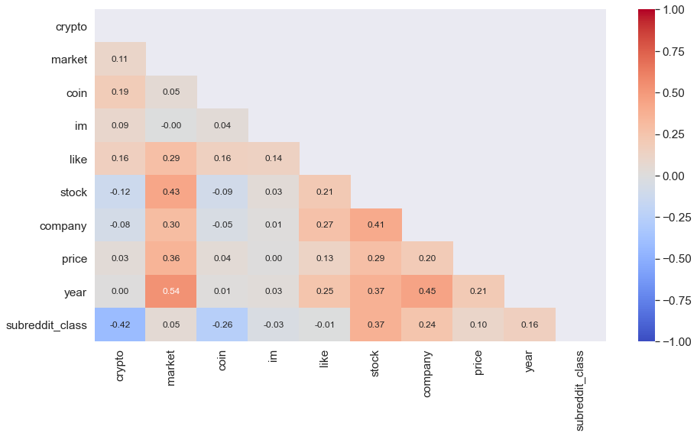
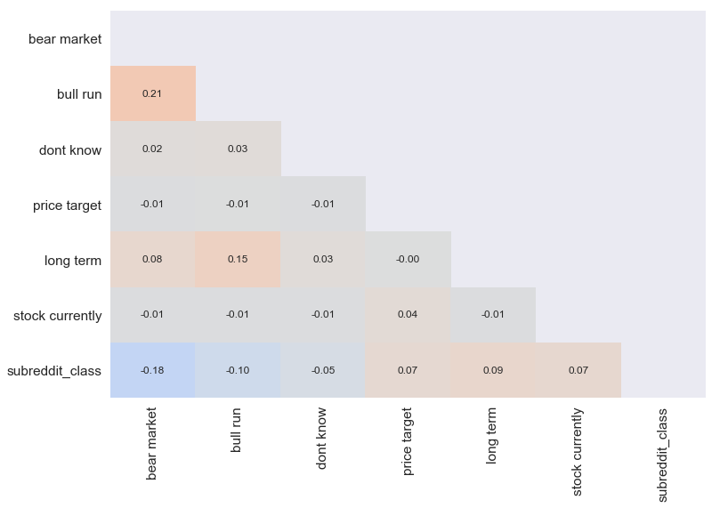
Heatmap for Feature Selection
Single words show a higher correlation than word pairs to the outcome of subreddit class.
Hence, only Count and TF-IDF vectorizers are used to convert the words to numeric values before model fitting.

Slide 19
Model Selection for Naive Bayes
Count Vectorizer
NB Model | Train Accuracy | Test Accuracy
Bernoulli Naïve Bayes | 76.2% | 72.1%
Multinomial Naïve Bayes | 96.5% | 93.0%
Gaussian Naïve Bayes | 97.4% | 80.4%
TF-IDF Vectorizer
NB Model | Train Accuracy | Test Accuracy
Bernoulli Naïve Bayes | 50.0% | 50.0%
Multinomial Naïve Bayes | 98.3% | 95.0%
Gaussian Naïve Bayes | 97.5% | 78.7%

Slide 20
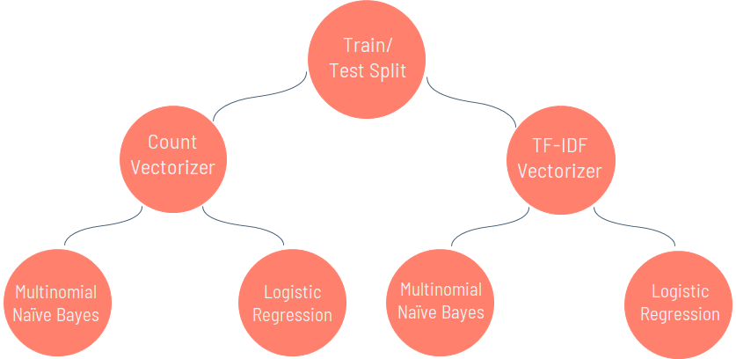
Model Preparation

Slide 21
Model Evaluation
Vectorizer | Classification Model | Accuracy | Sensitivity (Recall)
Count | Multinomial Naïve Bayes | 93.0% | 87.3%
Count | Logistic Regression | 95.6% | 95.7%
TF-IDF | Multinomial Naïve Bayes | 95.0% | 91.1%
TF-IDF | Logistic Regression | 96.1% | 97.3%
Notes:
Vectorizers
-For vectorizers, TF-IDF performs better than Count Vectorizer as it assigns a weightage score to each word
Classification Model
-Logistic Regression uses a structured model approach while KNN use a more data-centric approach
-Multinomial Naïve Bayes uses the probabilities of each word vector to calculate the final probability of the post.
-Logistic Regression takes into consideration the coefficient of each variable when determining the predicted probabilities of each post.
Sensitivity/Recall
-Sensitivity is defined as the percent (or proportion) of all 1s that are correctly classified as 1s. In this case, posts from r/stocks are classified as 1s.

Slide 22
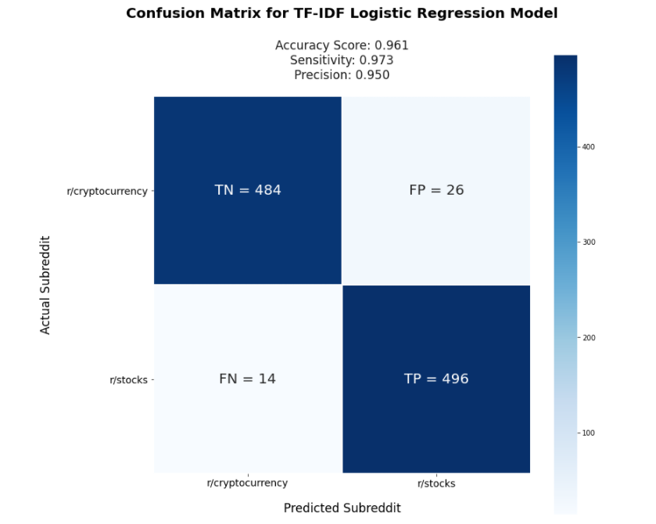
Our model performance is strong
Accurate classification > 96% of the time; 980 out of 1020 predictions
Sensitive classification ~97% relevant post detected
Out of 510 relevant posts, only 14 will be mis-labelled (~3%)
01
02

Slide 23
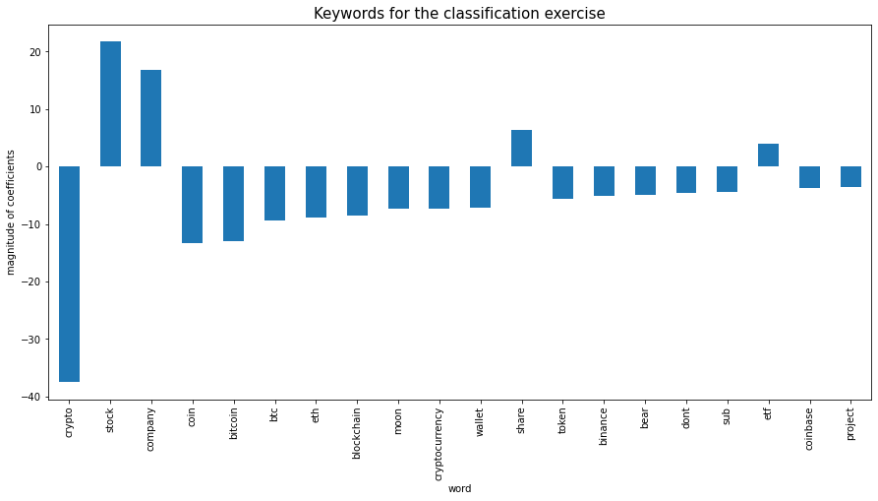
Some keywords are strong predictors of a post’s relevance to r/stocks or r/CryptoCurrency
Keywords for r/stocks
Stock, company, share, etf
Keywords for r/CryptoCurrency
Crypto, coin, bitcoin, btc, eth

Slide 24
Recommendations
Deploy the model for testing with live data
01
Given the strong performance of the model (96% accuracy score and 97% sensitivity score), we can benefit from deploying the model for pilot testing on the reddit platform.
Flag posts classified as irrelevant for moderators' assessment
02
There is a risk of incurring user frustrations if relevant posts are removed as a result of the model misclassification. To minimize wrongful post(s) removal, we can use the model's recommendation to flag posts for moderators' consideration.
Share keywords insights with the moderators
03
This can help moderators set rules for content posting using the AutoModerator to ensure irrelevant topics will not be posted within the community.

Slide 25
Future Steps
Collect data samples across a longer time (e.g. the past year) for training and model optimisation to pre-empt risk that the topics of discussion and keywords may change across different times of the year
Train the data using irrelevant posts from more than one source
Train and further optimise the model for production across more subreddit communities

Slide 26

Thanks!
Do you have any questions?

